Slide 1

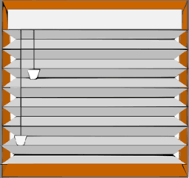
Smarter Blinds
Alejandro Avila
Alexis Lopez
Christopher Casillas
Erik Ramirez
Hector Leon

Slide 2

Motivation
Make manual blinds automated.

Slide 3
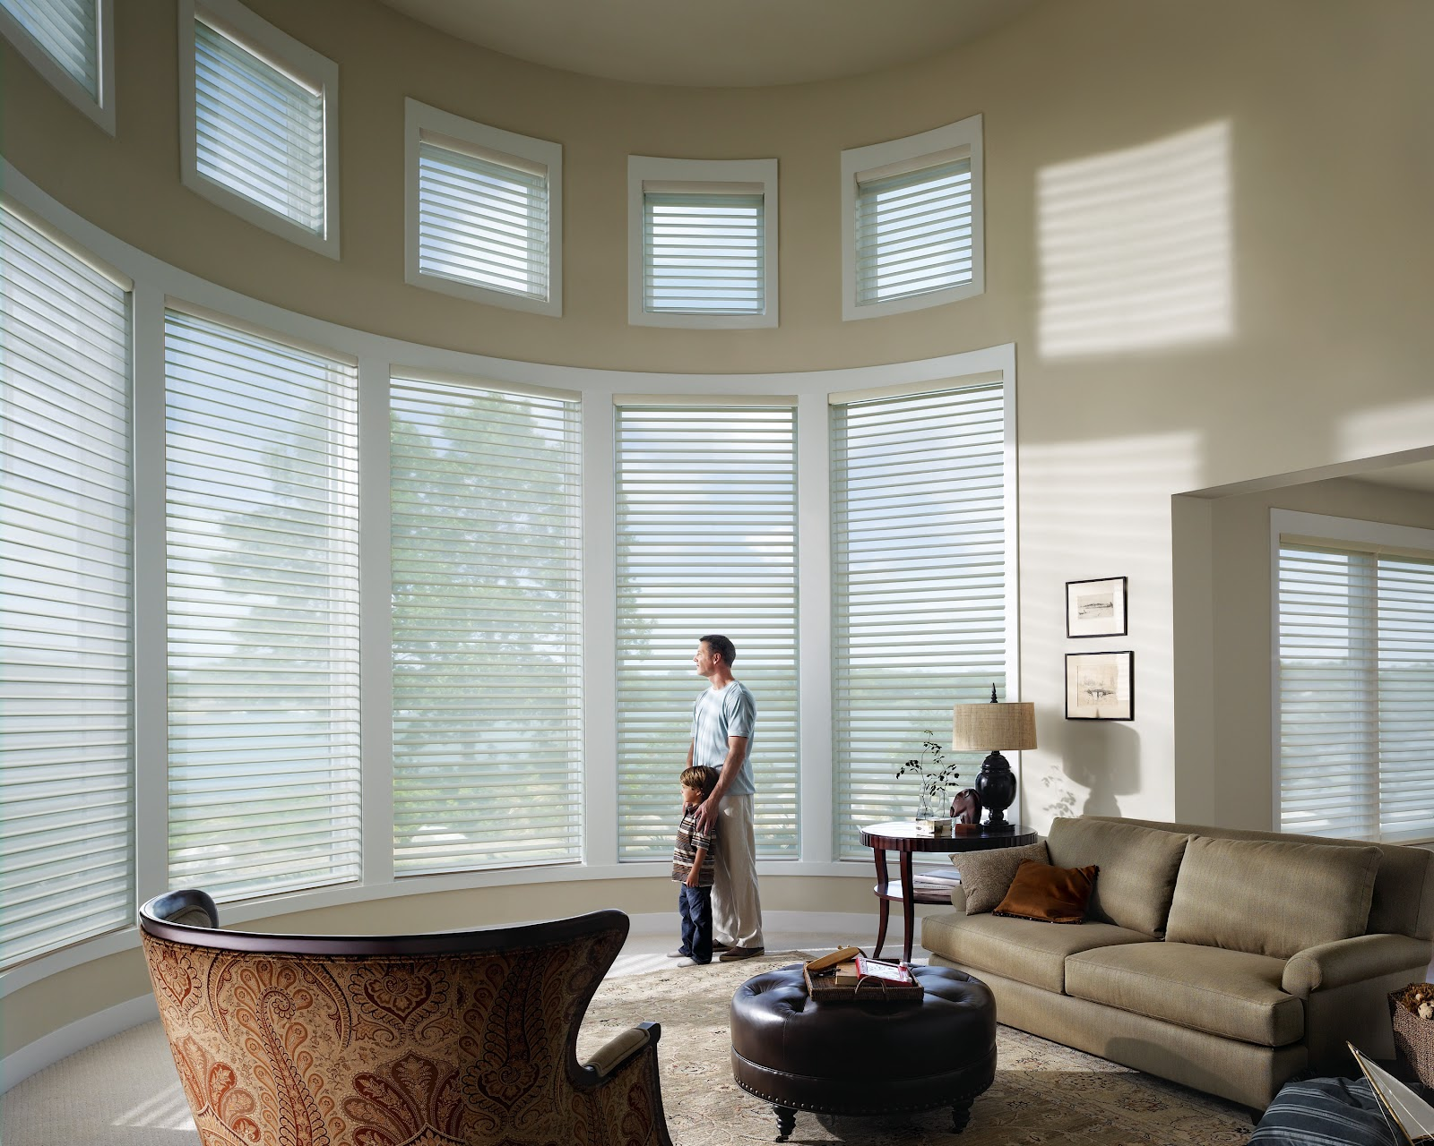
Motivation
Add an element of convenience to everyday blinds.

Slide 4
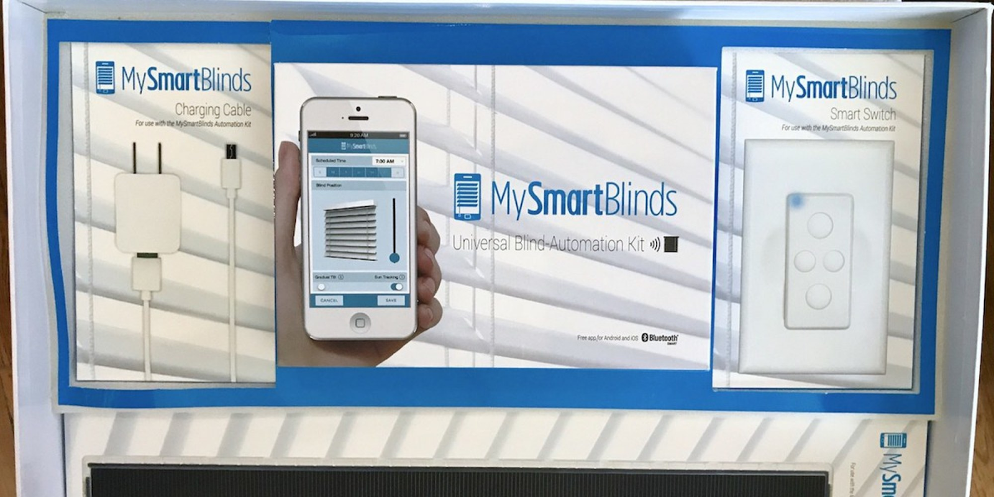
Examples-MySmartBlinds

Slide 5
Overview
Our focus is convenience
Minimize the cost and needed materials
Simplistic design/ user-friendly
Challenges: code, gathering materials, functioning design, …
Smarter Blinds

Slide 6
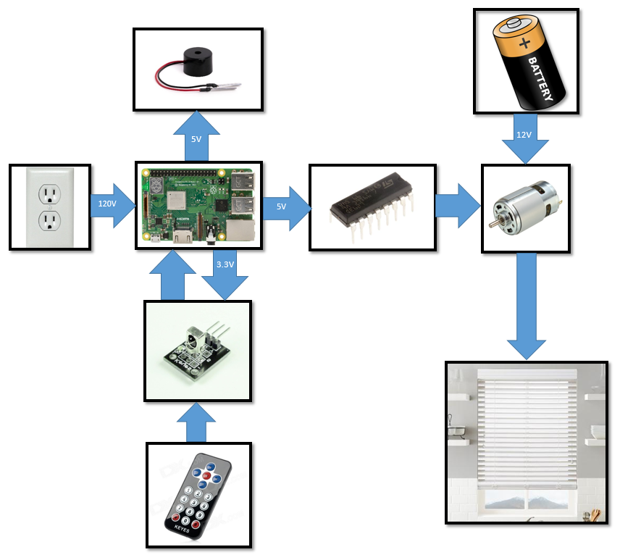
System Design
Raspberry Pi 3B+
DC motor to lower and raise the blinds.
IR Controller
Buzzer to signal specific actions

Slide 7
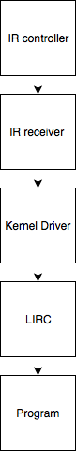
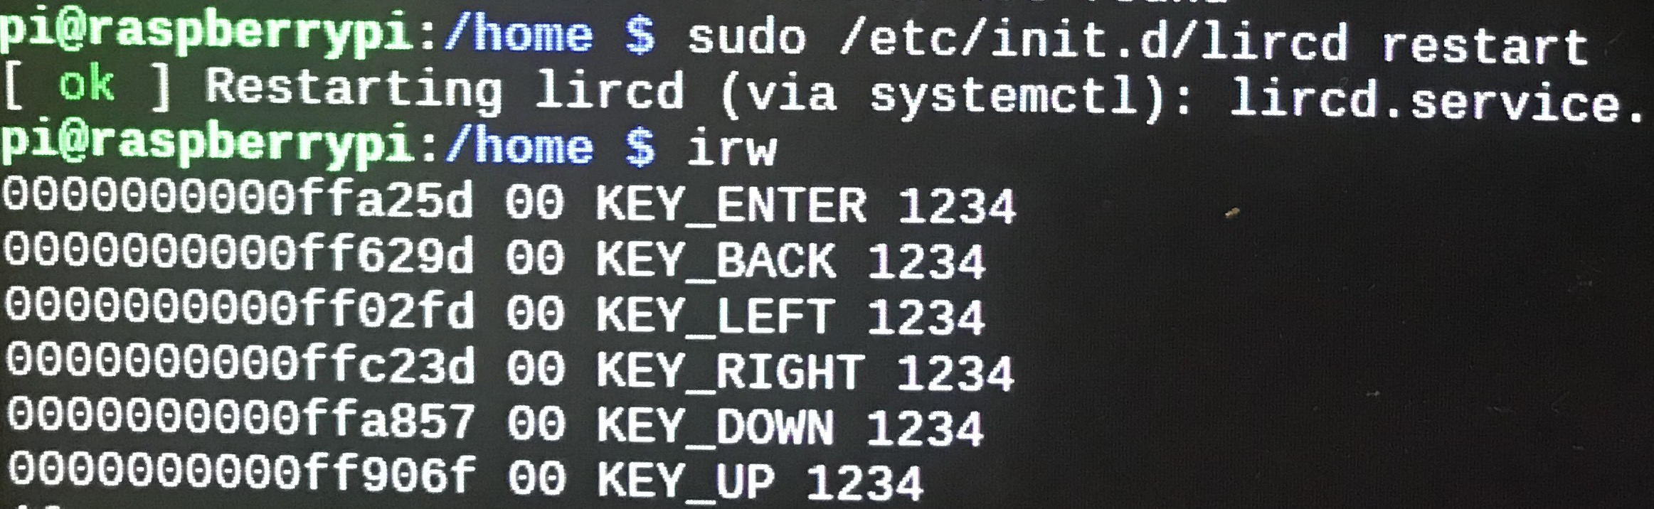
IR Controller
Linux Infrared Remote Control (LIRC)

Slide 8
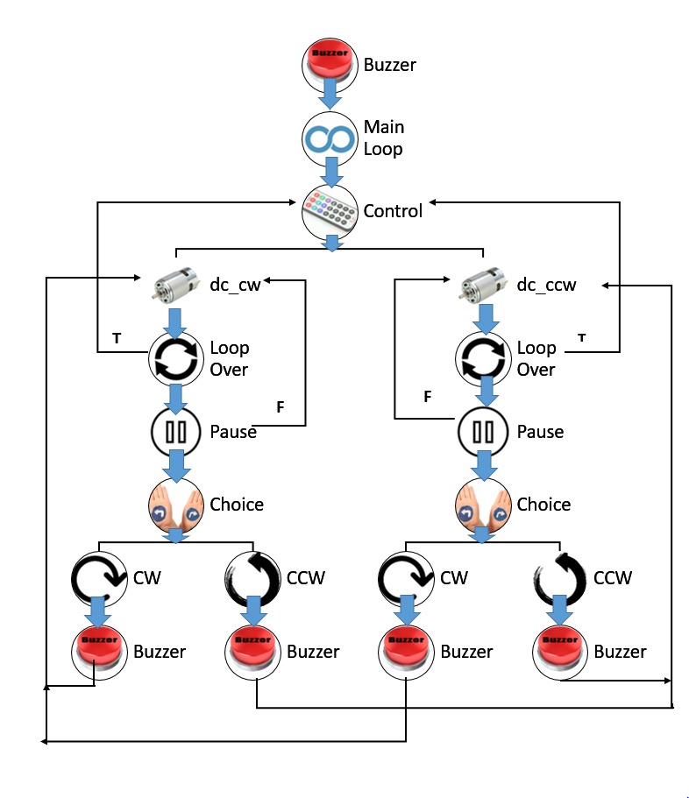
System Design
Legend:
cw – up/ open blinds
ccw – down/ close blinds

Slide 9
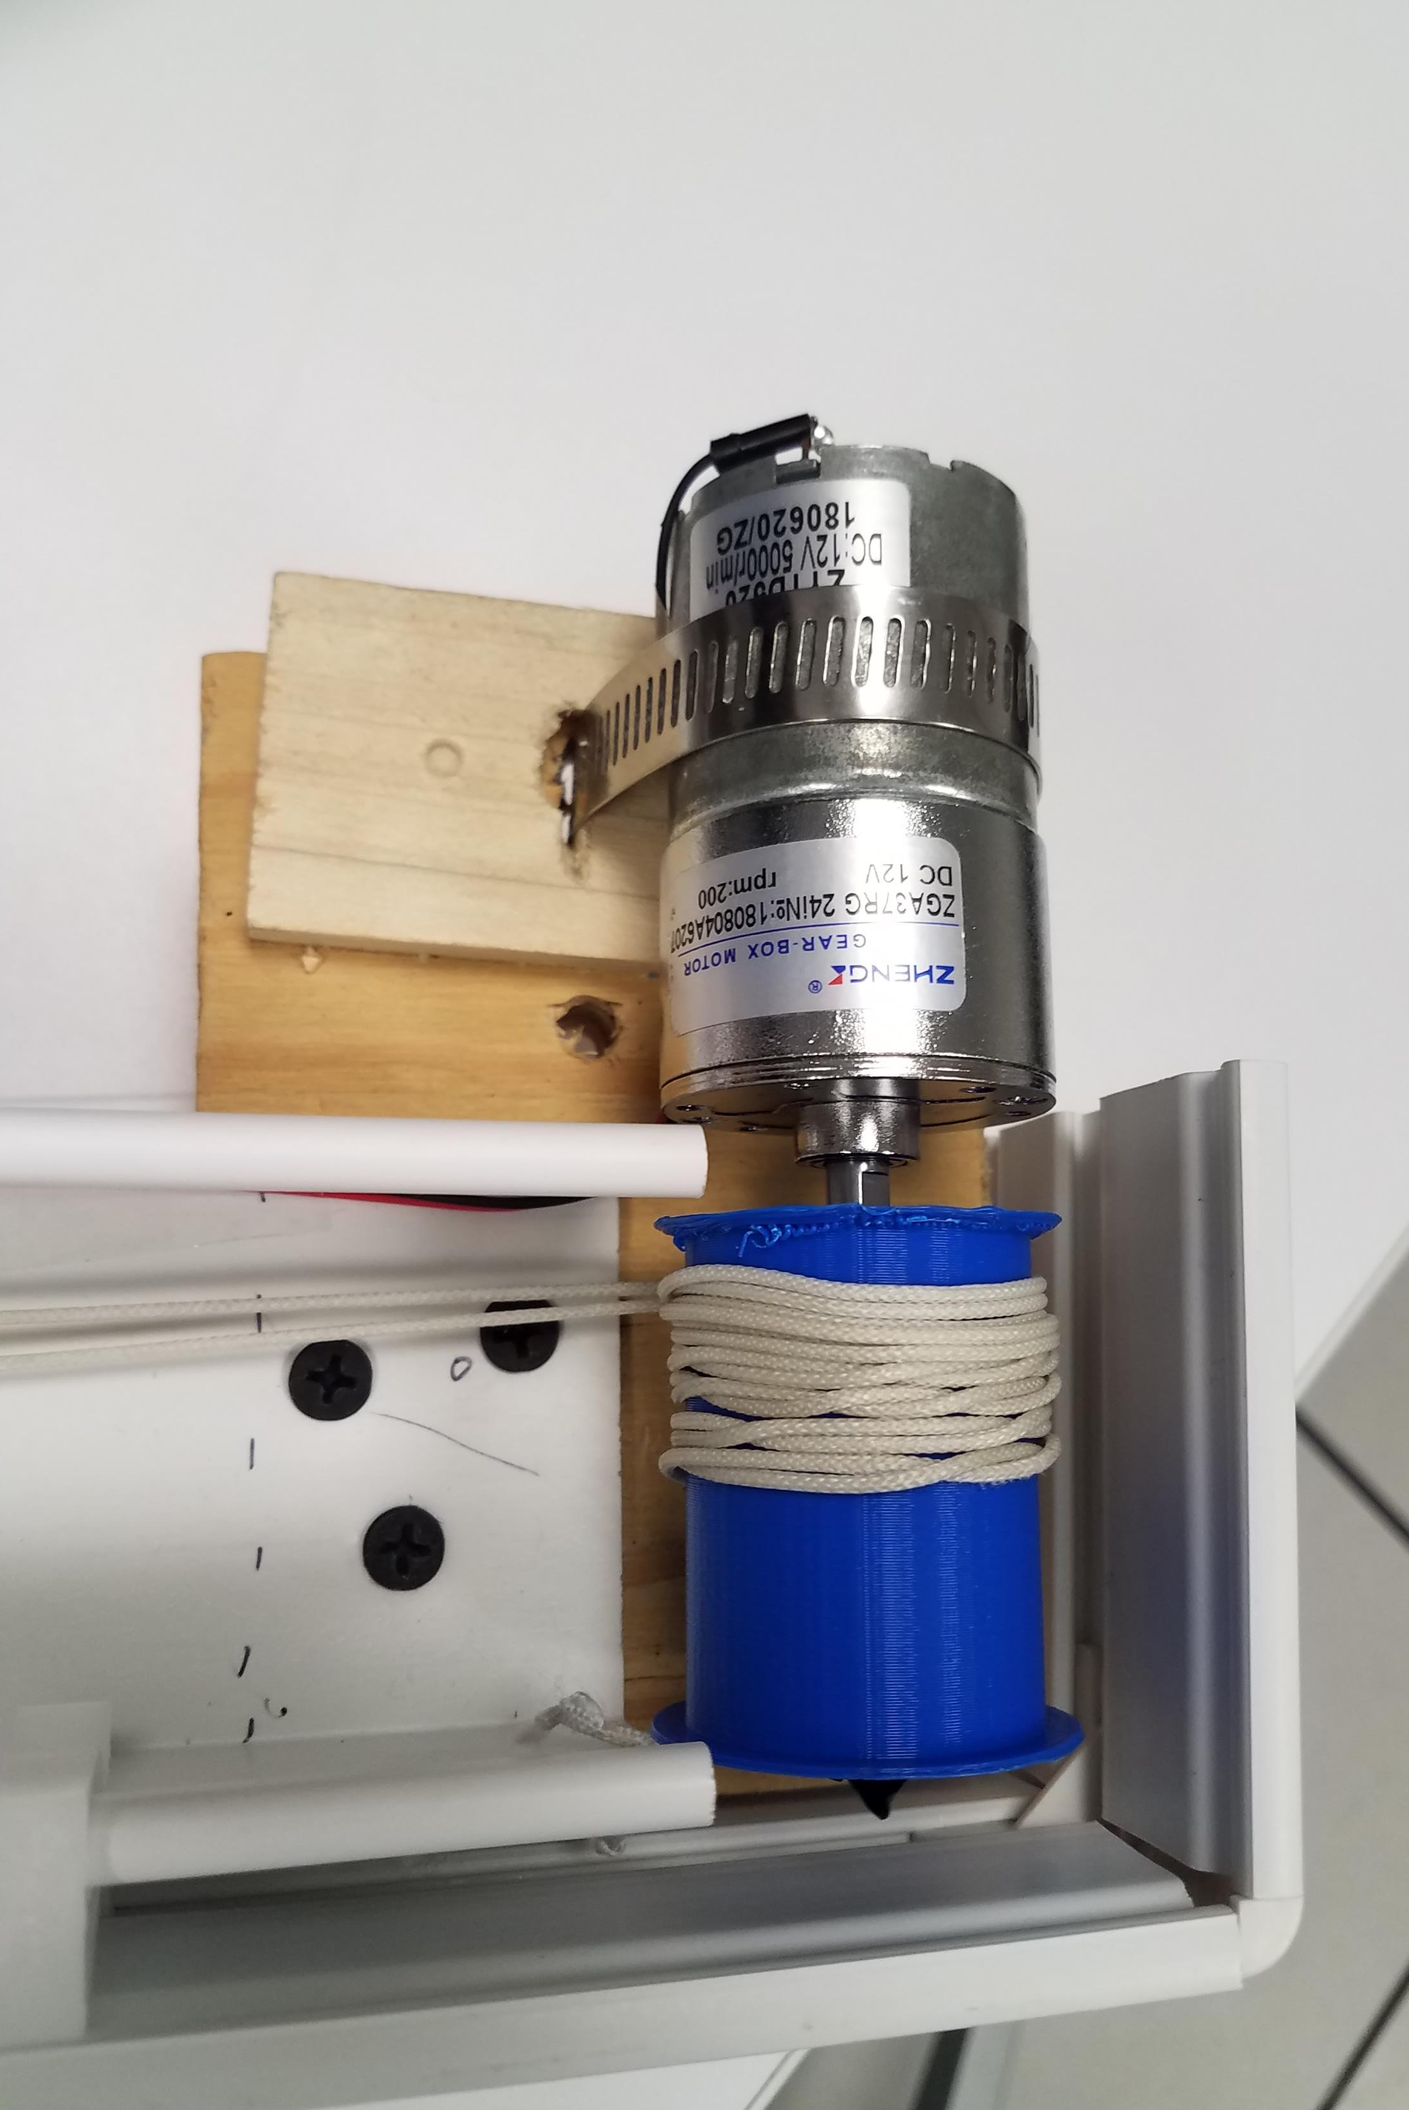
Challenges
Some key challenges include:
One of everything: only one person can work at a time.
Creating a clear cut design.
Gathering materials.
Maximizing the size of the spool and motor within the limited space of the blinds.
A spool to fit the motor.

Slide 10
Progress Report
First Prototype
Gear system
Second Prototype
3-D printed custom gears
Third Prototype
3-D printed custom spool

Slide 11
Progress Report
Next Quarter
Sensors, Angle
Future
Alexa, app

Slide 12
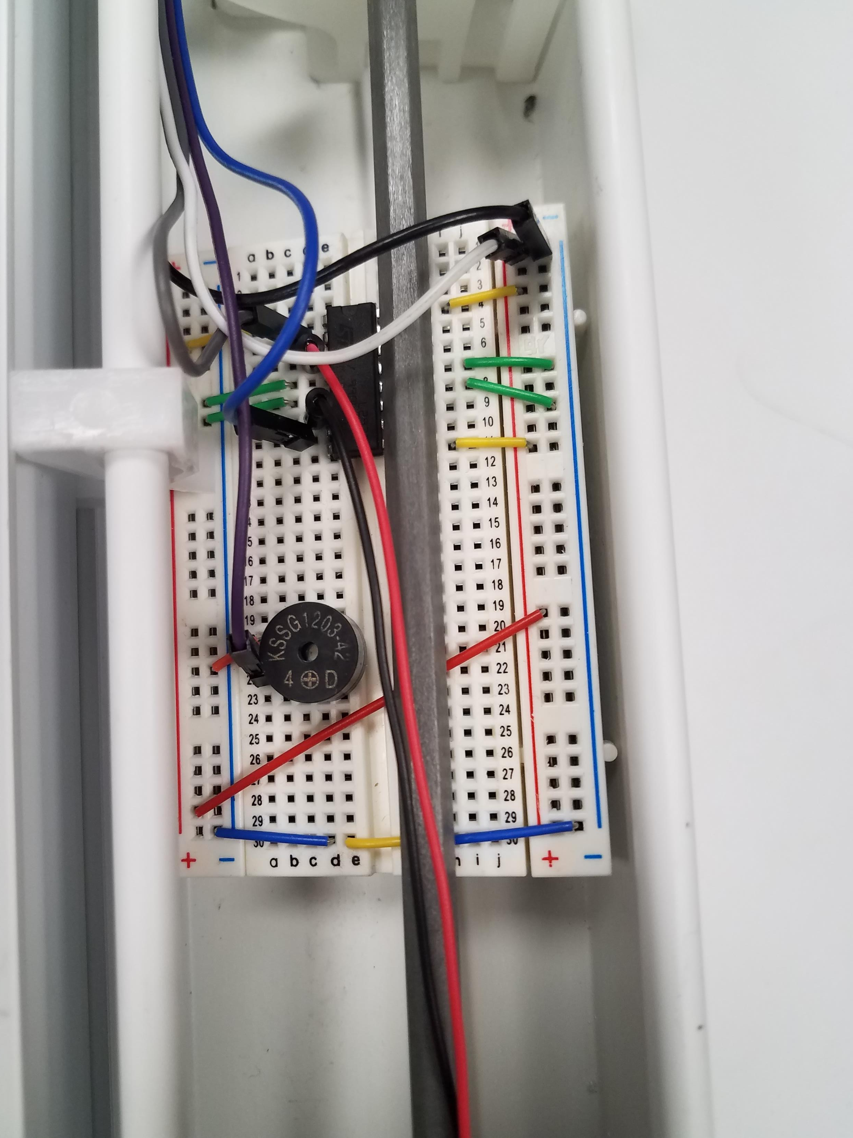
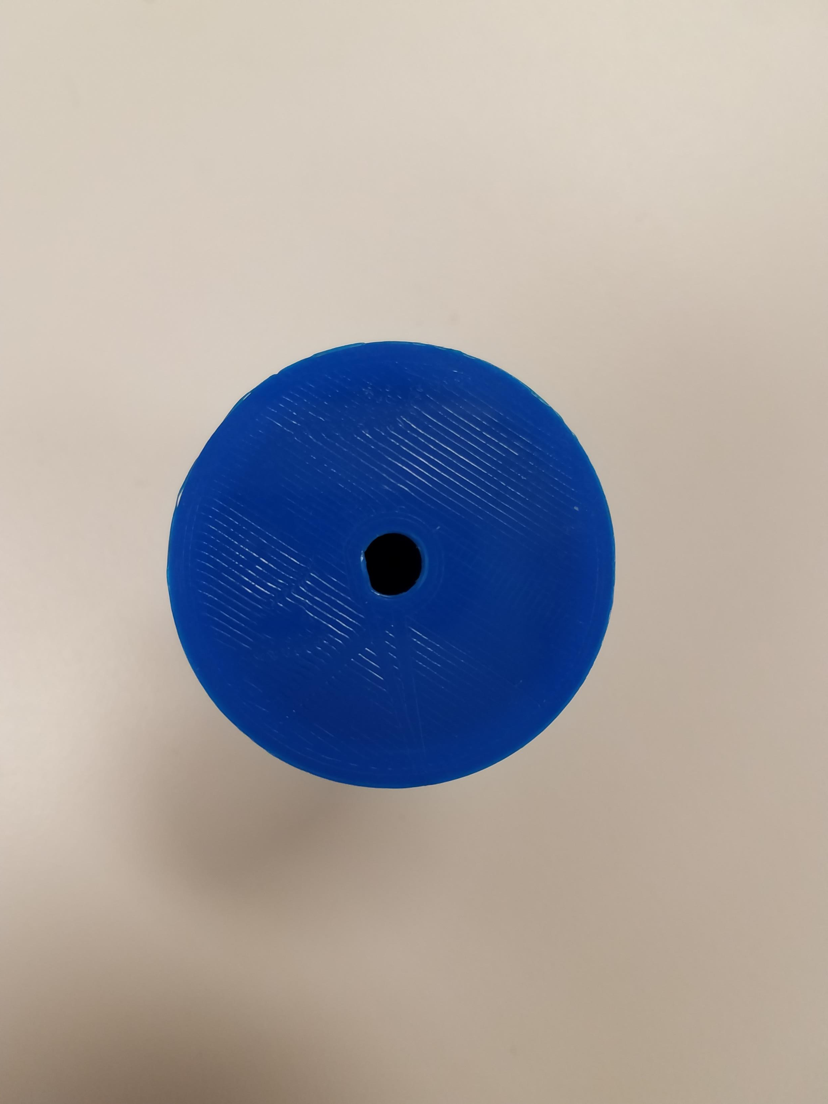
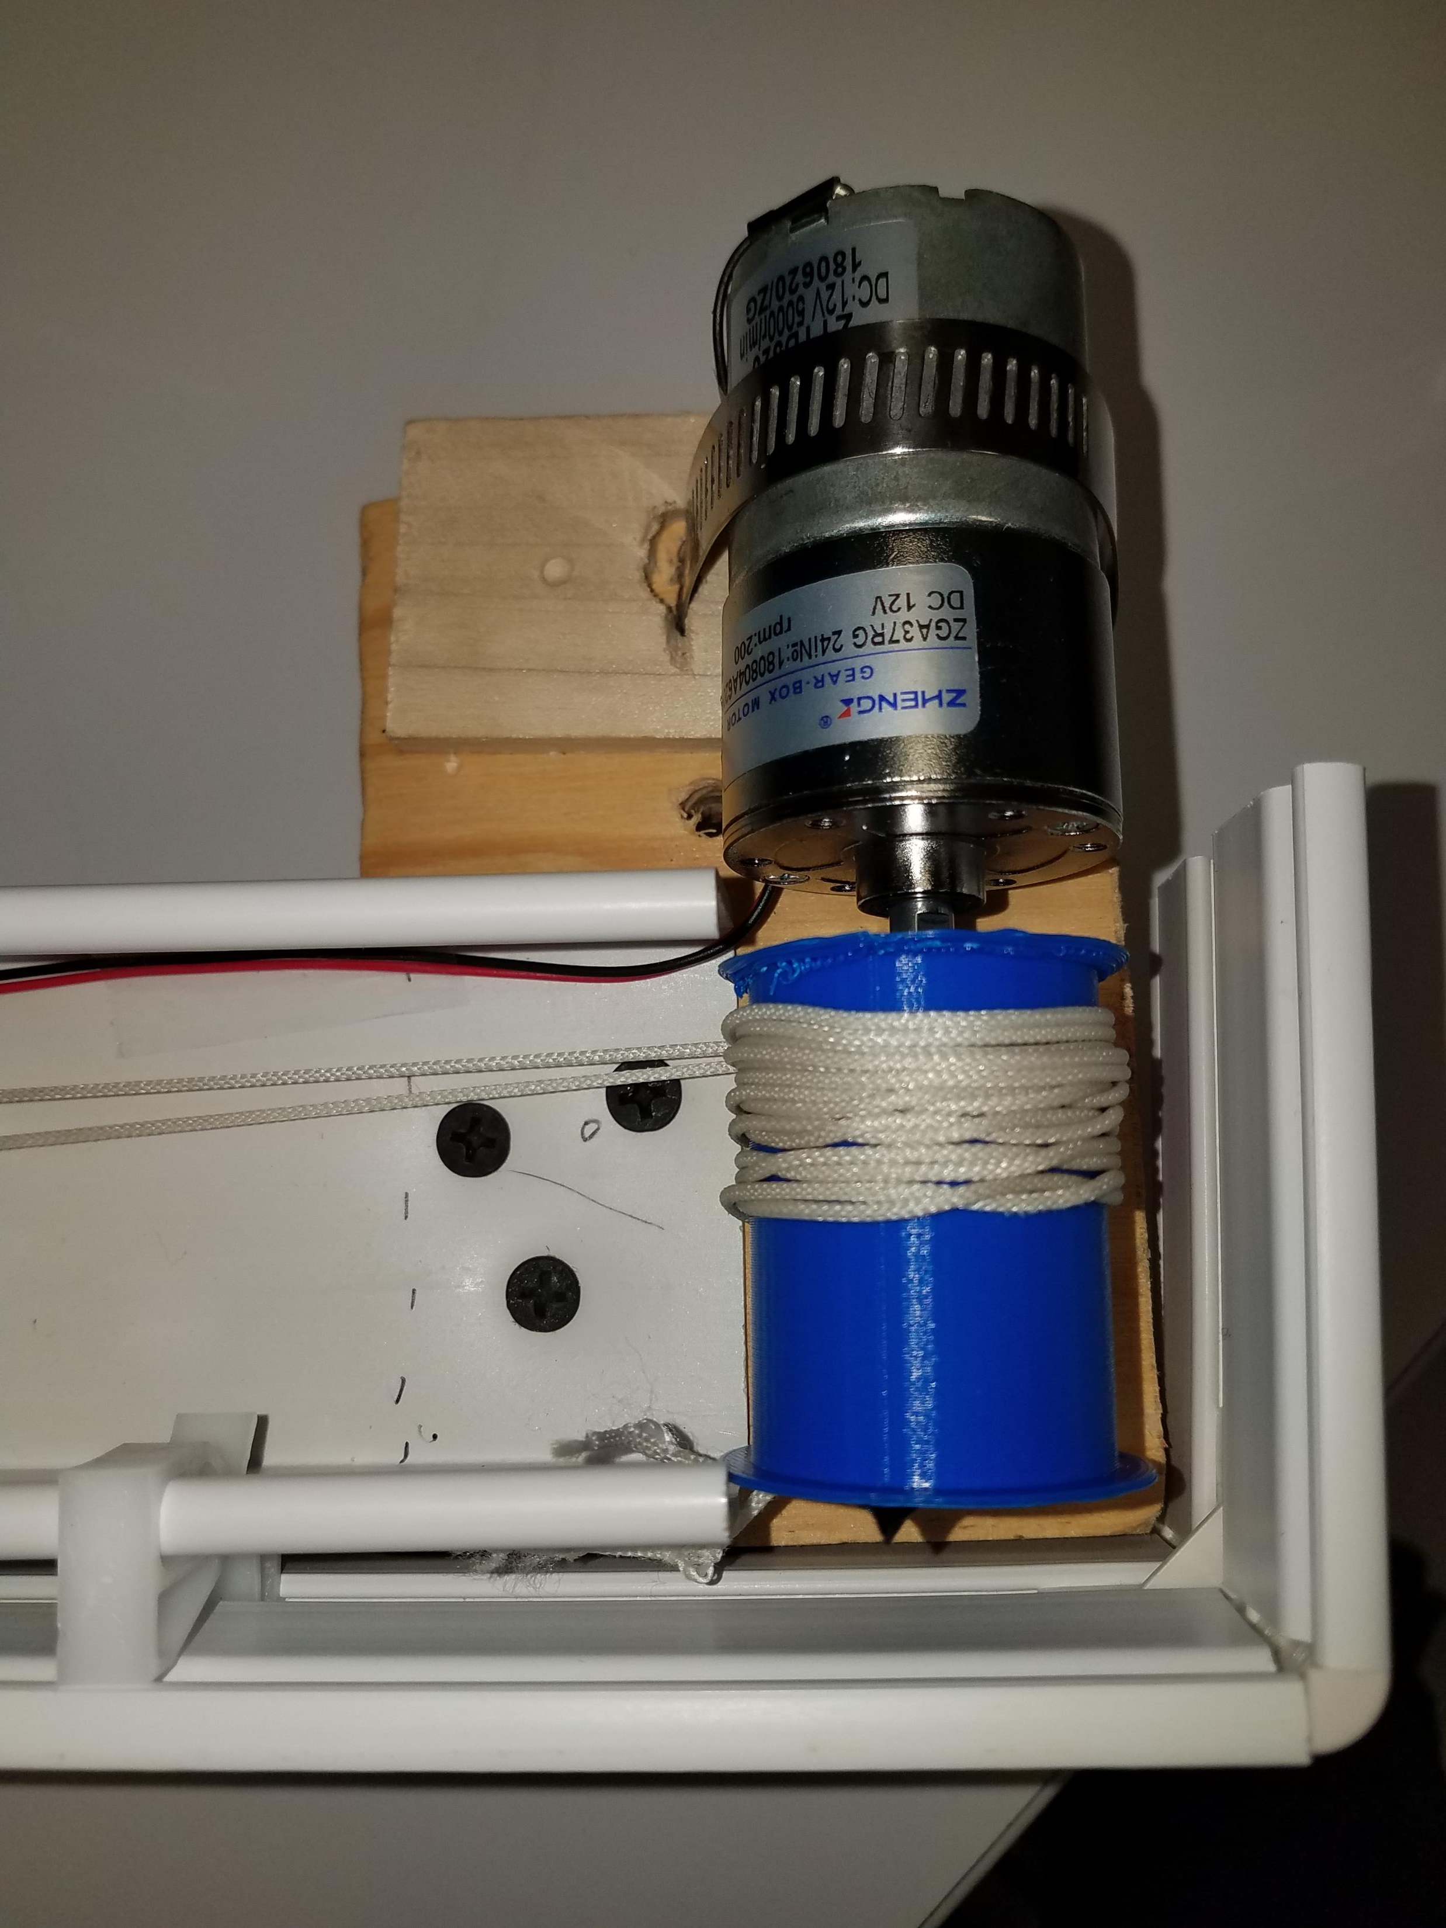
Evaluation and Discussion

Slide 13
Demo
…

